Slide 1
Design Patterns
Dirk Riehle, FAU Erlangen
ADAP D01
Licensed under CC BY 4.0 International

Slide 2
Agenda
Three design examples
The Composite pattern
Software design patterns
Other types of patterns
Describing design patterns
The Value Object pattern

Slide 3
1. Three Design Examples

Slide 4
Three Design Examples
File system
Financial portfolios
Test suites

Slide 5
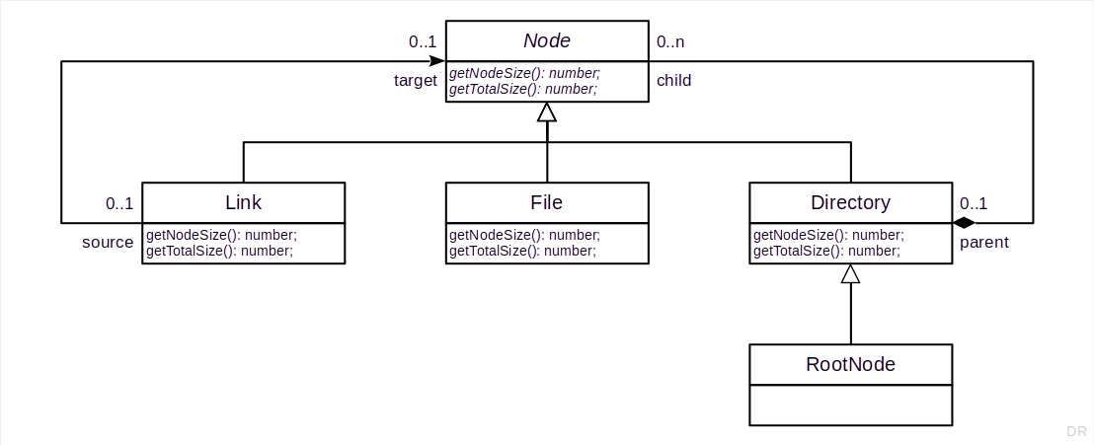
The File System Design Example

Slide 6
Node.getTotalSize() Exercise
# | Size | Type | Path | Who? | Result
1 | 1 | RootNode | /
2 | 1 | Directory | /usr
3 | 1 | Directory | /usr/bin
4 | 12 | File | /usr/bin/ls
5 | 579 | File | /usr/bin/code
6 | 1 | Directory | /media
7 | 1 | Directory | /home
8 | 1 | Directory | /home/riehle
9 | 10 | File | /home/riehle/.bashrc
10 | 344 | File | /home/riehle/wallpaper.jpg
11 | 1 | Directory | /home/riehle/projects

Slide 7
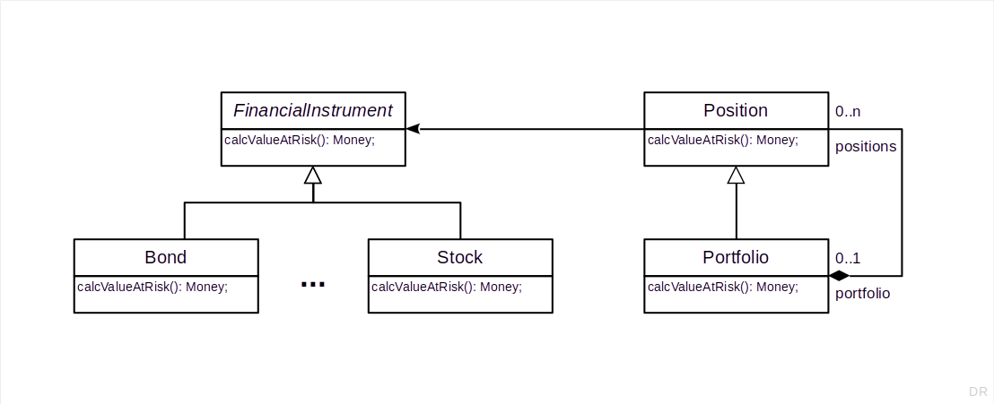
Example Design of a Financial Trading Application

Slide 8
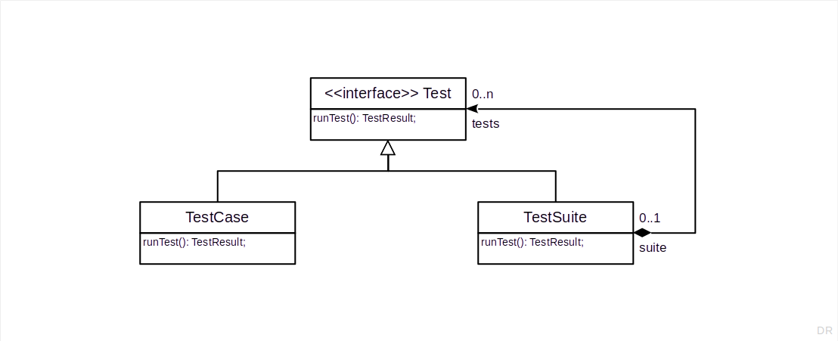
The Core JUnit Design (Java)

Slide 9
What is Common to the Three Examples?
Classes?
Names?
Structure?
Dynamics?

Slide 10
2. The Composite Pattern

Slide 11
Intent of the Composite Design Pattern
Compose objects into tree structures to represent part-whole hierarchies. Composite lets clients treat individual objects and compositions of objects uniformly.
[1] Gamma, E. et al. (1995). Design patterns. Addison Wesley.

Slide 12
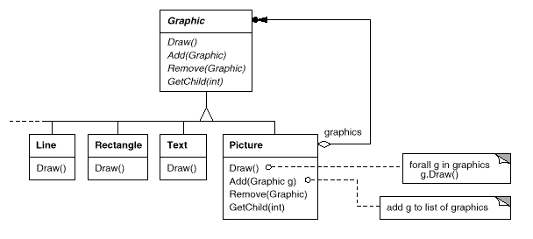
Motivation of the Composite Design Pattern

Slide 13
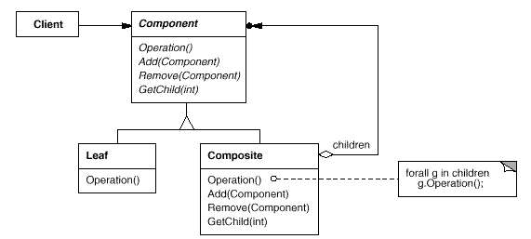
Structure Diagram of the Composite Design Pattern

Slide 14
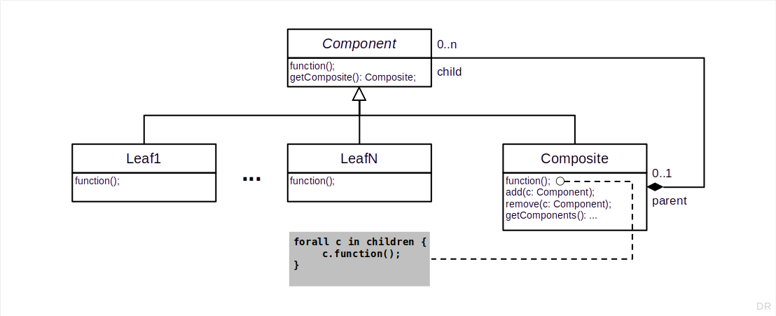
The Structure Diagram of the Composite Pattern

Slide 15
How Would You Model a Computer Configuration?
Hint: Use the Composite design pattern

Slide 16
3. Software Design Patterns

Slide 17
Design Pattern
A design pattern is (the abstraction from)
A recurring solution
To a recurring problem
In a defined context

Slide 18
Benefits of Using Design Patterns
Better, faster, cheaper …
Designing of software
Documenting of software
Communicating designs

Slide 19
The Design Patterns Book 1 / 2
The design patterns book [1]
A.k.a. the patterns catalog
A.k.a. the Gang-of-four book
is a seminal book that started the design patterns movement.
(Original German translation by yours truly [2].)
[1] Gamma, E. et al. (1995). Design patterns. Addison Wesley.
[2] Gamma, E. et al. (1996). Entwurfsmuster (Dirk Riehle, Trans.). Addison Wesley, Germany.

Slide 20
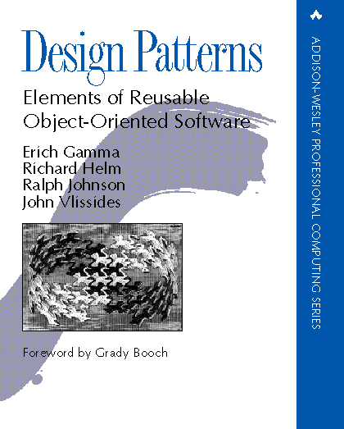
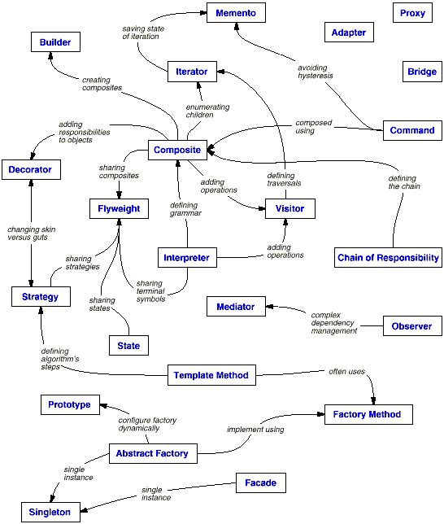
The Design Patterns Book 2 / 2

Slide 21
Beyond The Design Patterns Book?!
Null Object
Value Object
Type Object
Role Object
…

Slide 22
Sections of an Original Design Pattern Description [1]
1. Intent | 2. Also known as | 3. Motivation | 4. Applicability
5. Structure | 6. Participants | 7. Interactions | 8. Consequences
9. Implementation | 10. Example code | 11. Known uses | 12. Related patterns
[1] According to Gamma et al. (1995)

Slide 23
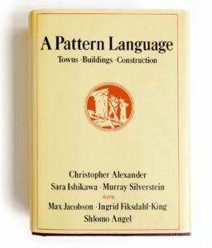
A Simpler Pattern Description
Context (where are we?)
Problem (what’s the problem?)
Solution (how to solve it)

Slide 24
The Composite Pattern as Context / Problem / Solution
Context
We need an easy way to work with a tree on every level
Problem
Each tree node must be able to represent the whole subtree
Solution
Move child object handling from node class into new subclass

Slide 25
A Highly Abridged History of Patterns in Software
A pattern language
“No object is an island”
ET++ and Interviews
The design pattern catalog
A system of patterns
The PLoPD book series
The TPLoP journal

Slide 26
4. Other Types of Patterns

Slide 27
Levels of Granularity
Architectural patterns (a.k.a. styles)
Design patterns
Programming idioms

Slide 28
Architectural Pattern Example
Event bus (a.k.a. publish/subscribe architecture)
Context
A software system of communicating components that come and go unbeknownst to each other
Problem
How to ensure components can send and receive all information they need?
Solution
Mediate communication between components through a bus that
Allows for the definition of event types
Can receive events for defined event types
Can distribute events to those registered for the event type

Slide 29
Architectural Style Example
Pipes and filters architecture (a.k.a. dataflow architecture)
Context
A system to transform data received from data sources for consumption by data sinks
Problem
How to flexibly create those systems from reusable components
Solution
Allow only for two types of components: Pipes and filters
Pipes receive data from filters or sources and distribute them to other filters or sinks
Filters receive data from pipes, process it, and feed it into further pipes
Build a pipes and filters system as a DAG from existing pipes and filters

Slide 30
The 23 Design Patterns from the Patterns Catalog
Creational Patterns
Abstract Factory (87)
Provide an interface for creating families of related or dependent objects without specifying their concrete classes.
Builder (97)
Separate the construction of a complex object from its representation so that the same construction process can create different representations.
Structural Patterns
Adapter (139)
Convert the interface of a class into another interface clients expect. Adapter lets classes work together that couldn't otherwise because of incompatible interfaces.
Bridge (151)
Decouple an abstraction from its implementation so that the two can vary independently.
Behavioral Patterns
Chain of Responsibility (223)
Avoid coupling the sender of a request to its receiver by giving more than one object a chance to handle the request. Chain the receiving objects and pass the request along the chain until an object handles it.
Command (233)
Encapsulate a request as an object, thereby letting you parameterize clients with different requests, queue or log requests, and support undoable operations

Slide 31
Programming Idiom Example [1]
class NumberArrayWithFixedIterator {
protected data: number[] = [];
protected count: number = 0;
constructor(data: number[]) {
this.data = [...data];
}
public getNextAndInc(): number {
const result = this.data[this.count++];
return result;
}
}
[1] PS: Anything wrong with this example?

Slide 32
5. Describing Design Patterns

Slide 33

What Notation is This? [1]
[1] Also see https://forms.gle/UzXAB4i3e7cSRLXt8

Slide 34
Illustration vs. Template
An illustration is
A made-for-humans informal description (of a design pattern)
A template is a model that is
A sufficiently formal description that can be applied to deliver an instance
The structure diagram is an illustration of the most common form

Slide 35
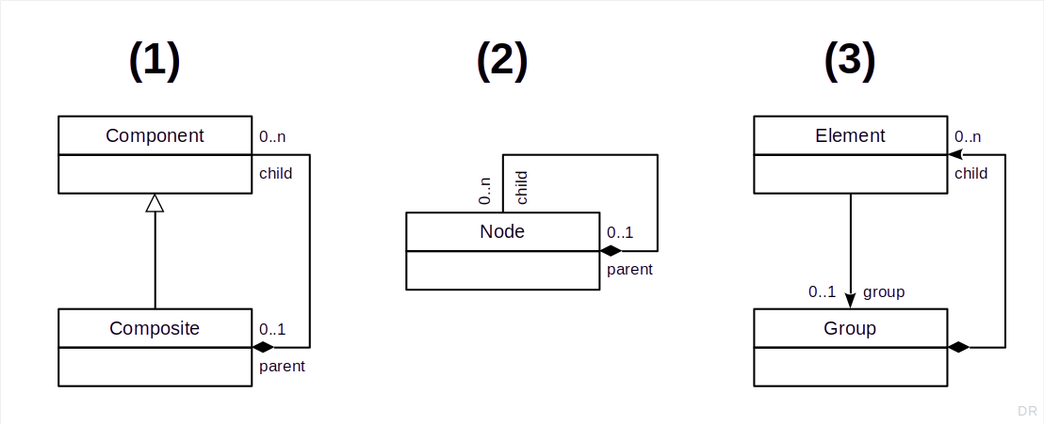
Variations of the Composite Pattern’s Structure

Slide 36
Pattern Collections
Pattern catalogs
Pattern handbooks
Pattern languages

Slide 37
6. The Value Object Pattern

Slide 38
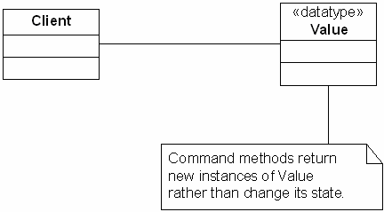
The Value Object Pattern
Design pattern book style [1]
Intent
Implement data types as immutable classes so that their instances can be handled like built-in values.
Structure
Alexanderian form
Context
Any object-oriented system
Problem
You can’t natively express values
Solution
Implement value types as immutable classes
[1] Riehle, D. (2006). Value Object. In Proceedings of the 2006 Conference on Pattern Languages of Programming (PLoP ’06). ACM: Article no. 30, pp. 1-6.

Slide 39
Some Design Patterns Could be Language Features
Visitor → Double-dispatch (or multiple dispatch) function calling
Value Object → Domain-specific values as first-class citizens
Type Object → Types as first class citizens (a.k.a. Meta Object)
Role Object → Traits and collaborations as first class citizens

Slide 40
Summary
Three design examples
The Composite pattern
Software design patterns
Other types of patterns
Describing design patterns
The Value Object pattern

Slide 41
Thank you! Any questions?
dirk.riehle@fau.de – https://oss.cs.fau.de
dirk@riehle.org – https://dirkriehle.com – @dirkriehle

Slide 42
Legal Notices
License
Licensed under the CC BY 4.0 International license
Copyright
© 2012, 2018, 2024 Dirk Riehle, some rights reserved

